Slide 1

Waze User Churn Project
Part of Google Advanced Data Analytics Certification

Slide 2
What factors are likely to make user churn?

Slide 3
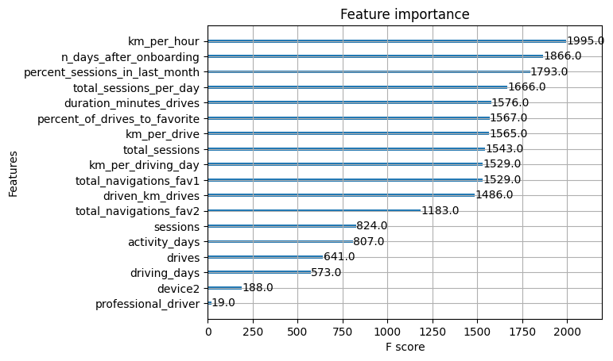
The XGBoost model was built
This model shows that the current data is insufficient to consistently predict churn.
Engineered features are in the top 10 features:
km_per_hour, percent_sessions_in_last_month, total_sessions_per_day, percent_of_drives_to_favorite, km_per_drive, km_per_driving_day
Notes:
It would be helpful to have drive-level information for each user (such as drive times, geographic locations, etc.). It would probably also be helpful to have more granular data to know how users interact with the app. For example, how often do they report or confirm road hazard alerts? Finally, it could be helpful to know the monthly count of unique starting and ending locations each driver inputs

